Slide 1
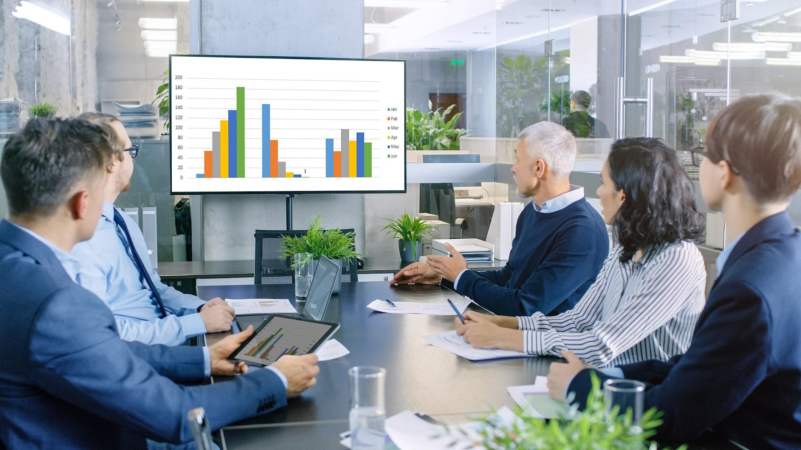

Business Insights
360
Live Dashboard

Slide 2

Table of Contents :
Introduction
Project Overview
Data Model
Home Page
Finance View
Sales View
Marketing View
Supply Chain View
Executive View
Info
Support

Slide 3
Introduction
Atliq Hardware is an emerging company in the hardware industry, poised for significant growth and innovation. The Business 360 Analysis aims to provide a comprehensive evaluation of Atliq Hardware’s performance from multiple perspectives. Utilizing a curated Power BI dashboard, this analysis will offer a data-driven approach to understanding the company's strengths, weaknesses, opportunities, and threats. The ultimate goal is to equip Atliq Hardware with actionable insights to drive strategic decision-making and ensure sustainable growth.

Slide 4
Project Overview :
The project focuses on analyzing the data of Atliq's business to gain insights into its overall operations. Through the data provided in the subsequent slides, we can conduct a thorough analysis of the business across various functions including finance, sales, marketing, and supply chain. Additionally, executive dashboards will be utilized to provide a comprehensive overview of the business performance.
It is essential to leverage this data to identify growth opportunities, optimize processes, and make informed decisions that drive the business forward. By analyzing key metrics and trends, we can uncover patterns and insights that will guide strategic planning and resource allocation.
Overall, the analysis of Atliq's data will enable us to enhance operational efficiency, improve customer satisfaction, and ultimately drive business success. Let's delve into the data and unlock the potential for growth and innovation within the organization.

Slide 5
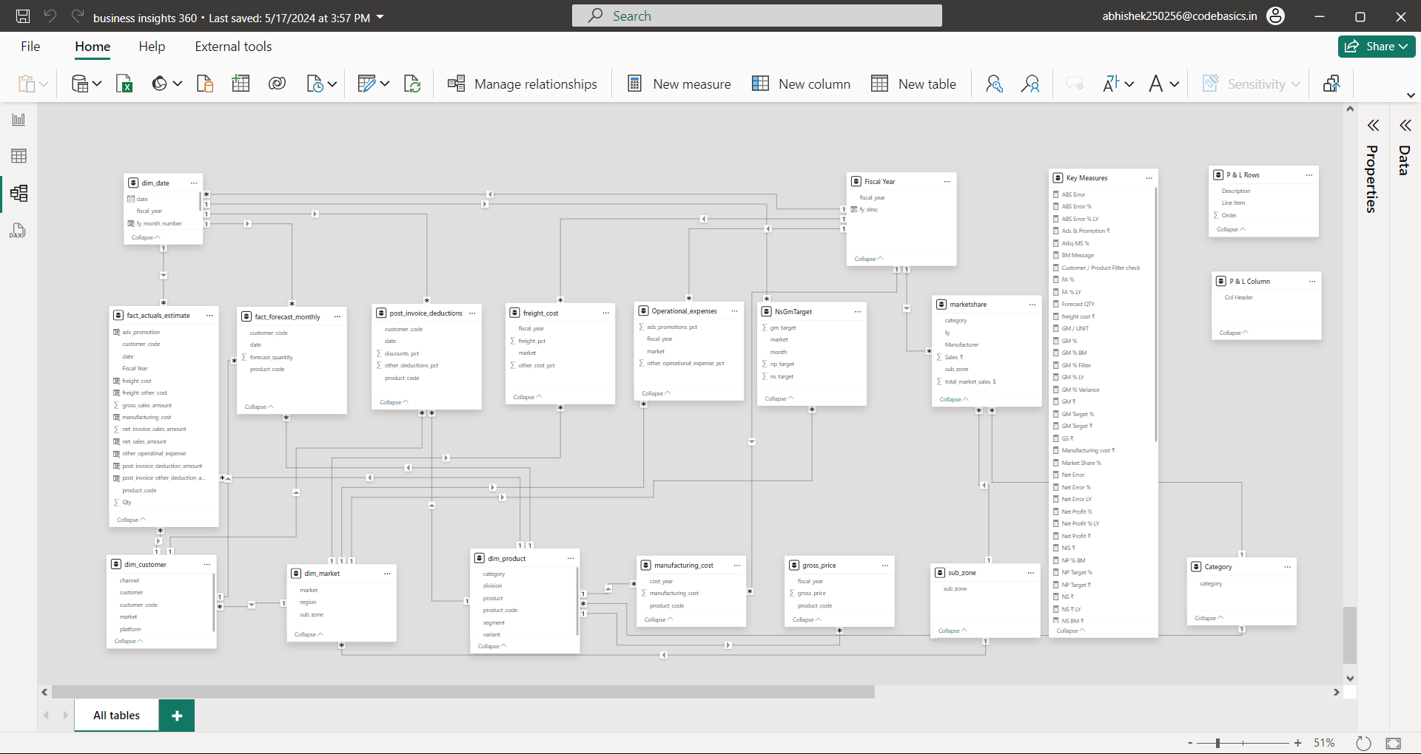

Slide 6
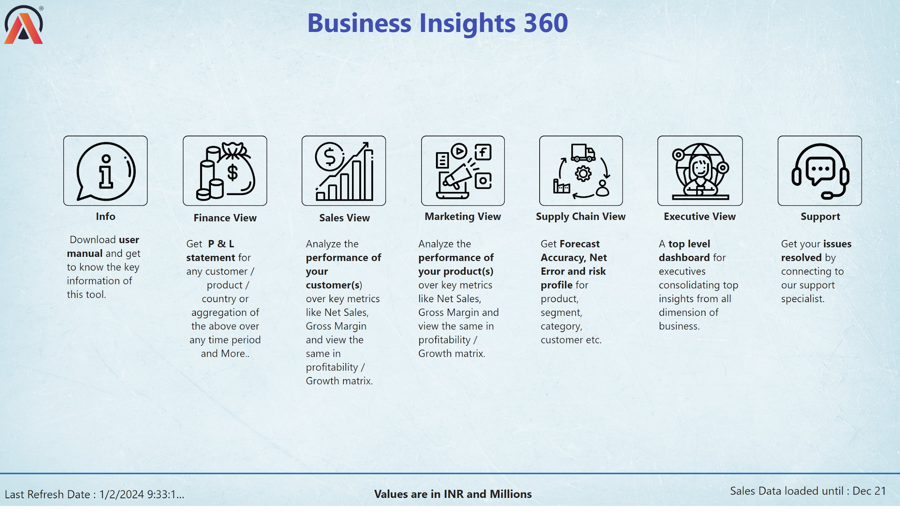
Notes:
image
No alt text provided
image
No alt text provided
image
No alt text provided
image
No alt text provided
image
No alt text provided
image
No alt text provided
image
No alt text provided
textbox
No alt text provided
image
No alt text provided
textbox
No alt text provided
textbox
No alt text provided
textbox
No alt text provided
textbox
No alt text provided
textbox
No alt text provided
textbox
No alt text provided
textbox
No alt text provided
textbox
No alt text provided
textbox
No alt text provided
textbox
No alt text provided
textbox
No alt text provided
textbox
No alt text provided
textbox
No alt text provided
textbox
No alt text provided
card
No alt text provided
shape
No alt text provided
card
No alt text provided
textbox
No alt text provided

Slide 7
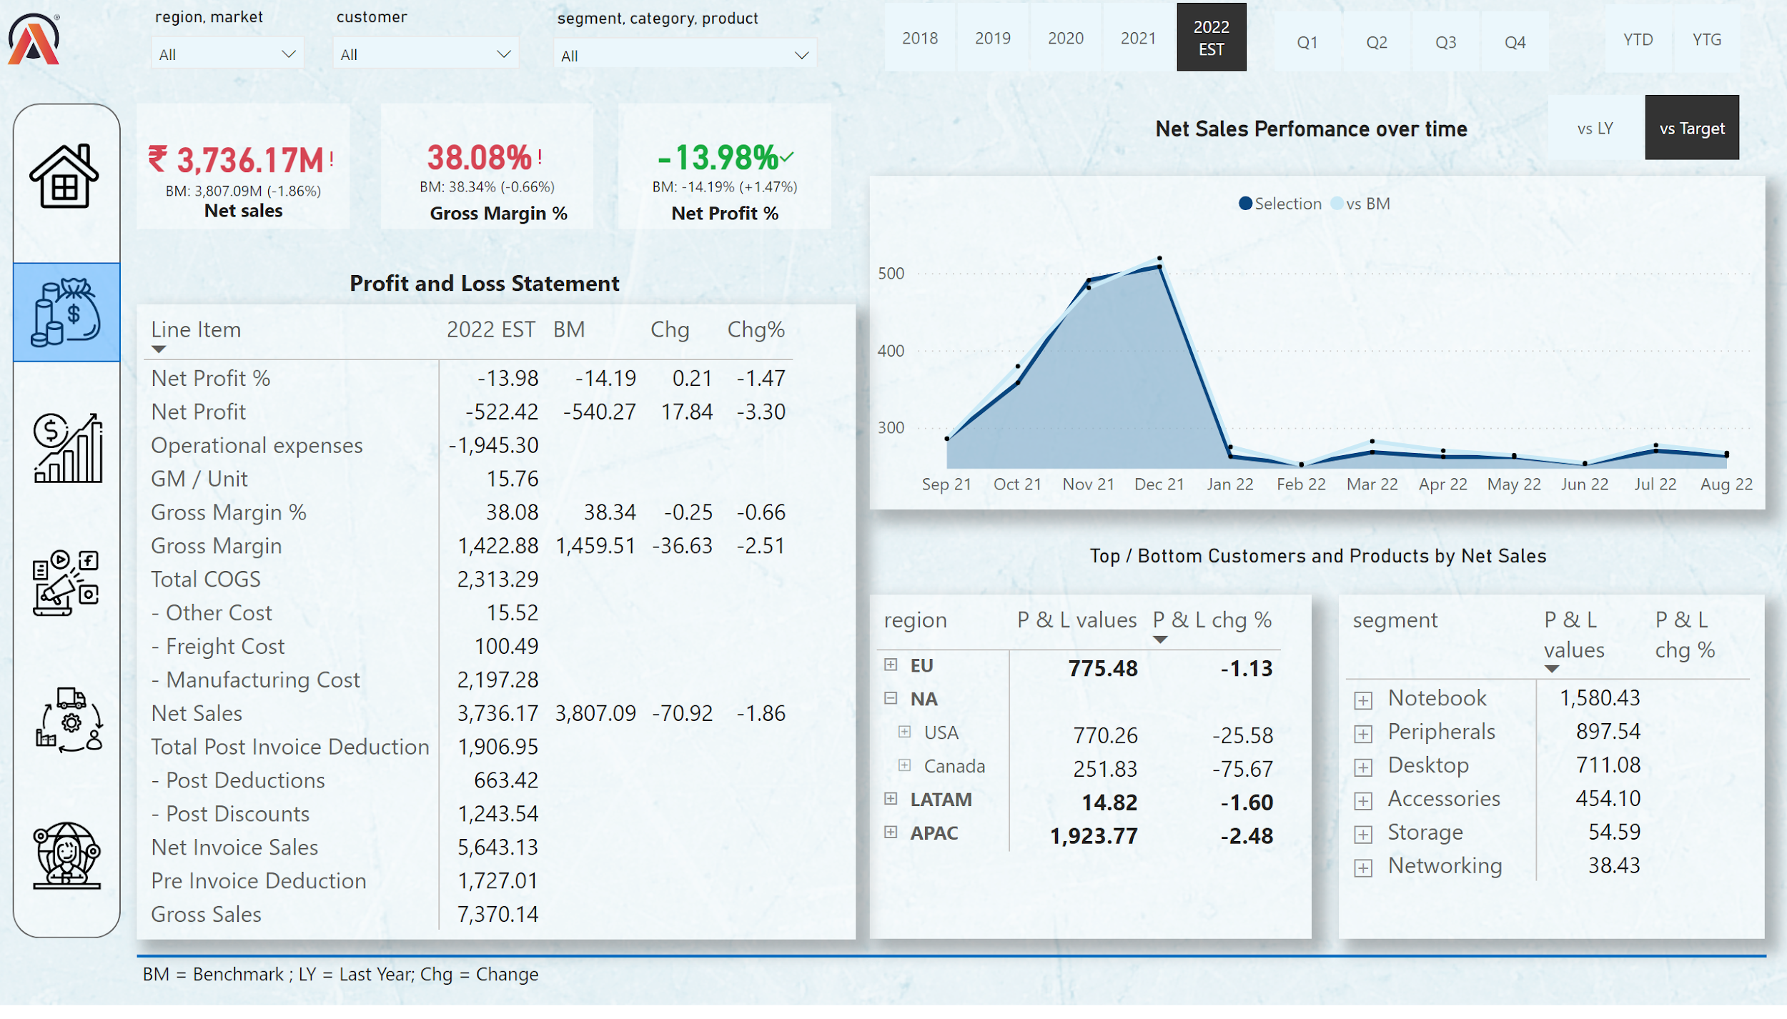
Notes:
pivotTable
No alt text provided
slicer
No alt text provided
slicer
No alt text provided
slicer
No alt text provided
Net Sales
No alt text provided
pivotTable
No alt text provided
pivotTable
No alt text provided
card
No alt text provided
card
No alt text provided
slicer
No alt text provided
slicer
No alt text provided
slicer
No alt text provided
textbox
No alt text provided
kpi
No alt text provided
textbox
No alt text provided
kpi
No alt text provided
kpi
No alt text provided
textbox
No alt text provided
textbox
No alt text provided
image
No alt text provided
shape
No alt text provided
image
No alt text provided
image
No alt text provided
image
No alt text provided
image
No alt text provided
image
No alt text provided
image
No alt text provided
shape
No alt text provided
textbox
No alt text provided
slicer
No alt text provided
card
No alt text provided
shape
No alt text provided

Slide 8
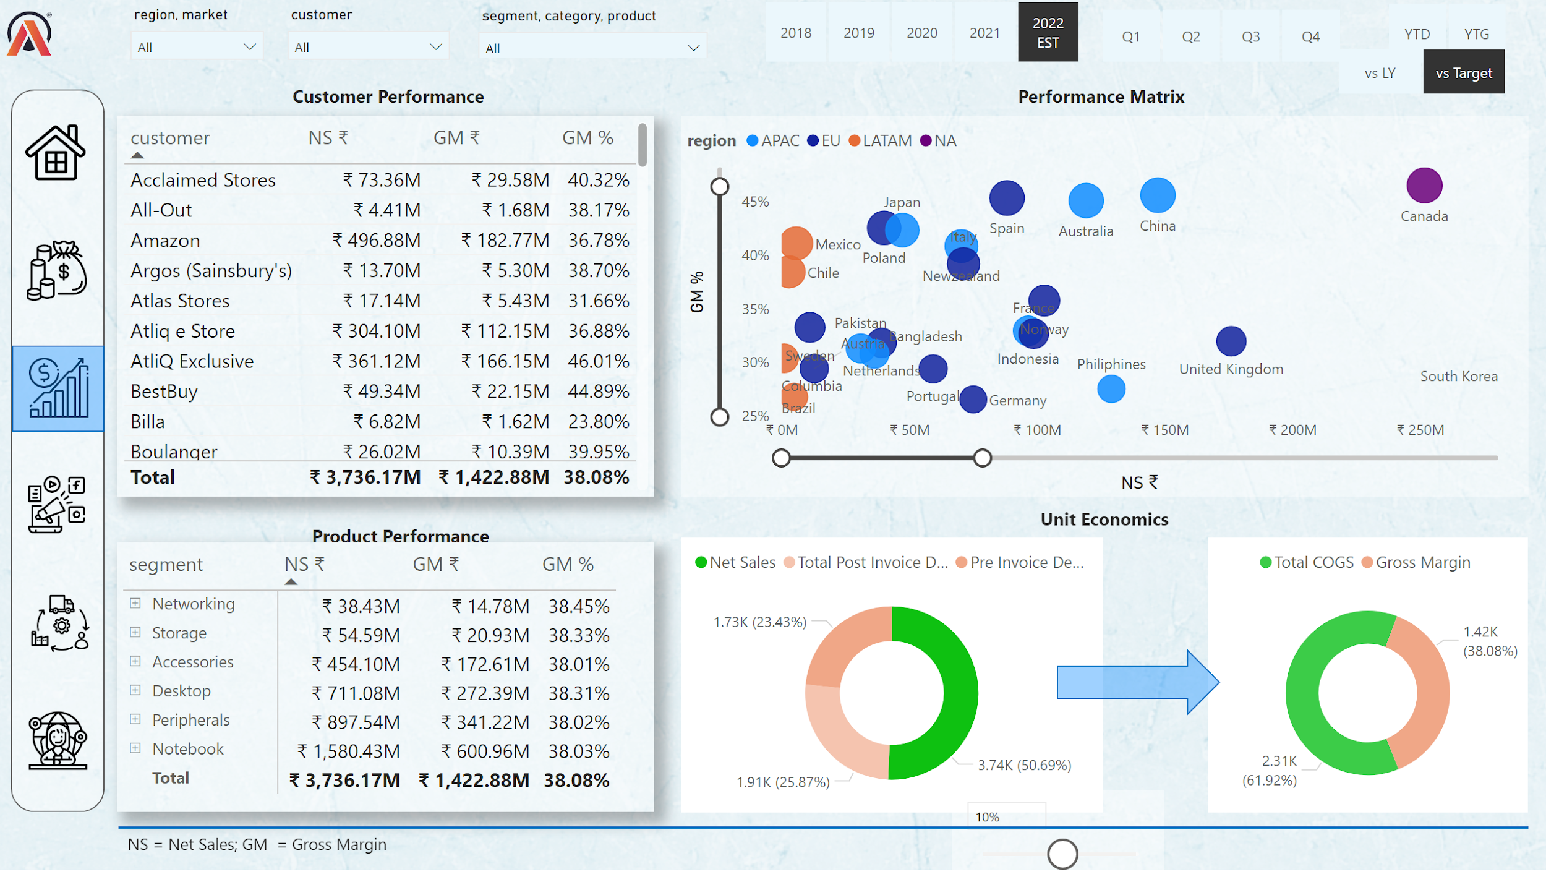
Notes:
slicer
No alt text provided
slicer
No alt text provided
slicer
No alt text provided
slicer
No alt text provided
slicer
No alt text provided
slicer
No alt text provided
image
No alt text provided
shape
No alt text provided
image
No alt text provided
image
No alt text provided
image
No alt text provided
image
No alt text provided
image
No alt text provided
image
No alt text provided
shape
No alt text provided
tableEx
No alt text provided
pivotTable
No alt text provided
textbox
No alt text provided
textbox
No alt text provided
textbox
No alt text provided
scatterChart
No alt text provided
donutChart
No alt text provided
donutChart
No alt text provided
shape
No alt text provided
textbox
No alt text provided
slicer
No alt text provided
slicer
No alt text provided
shape
No alt text provided
textbox
No alt text provided

Slide 9
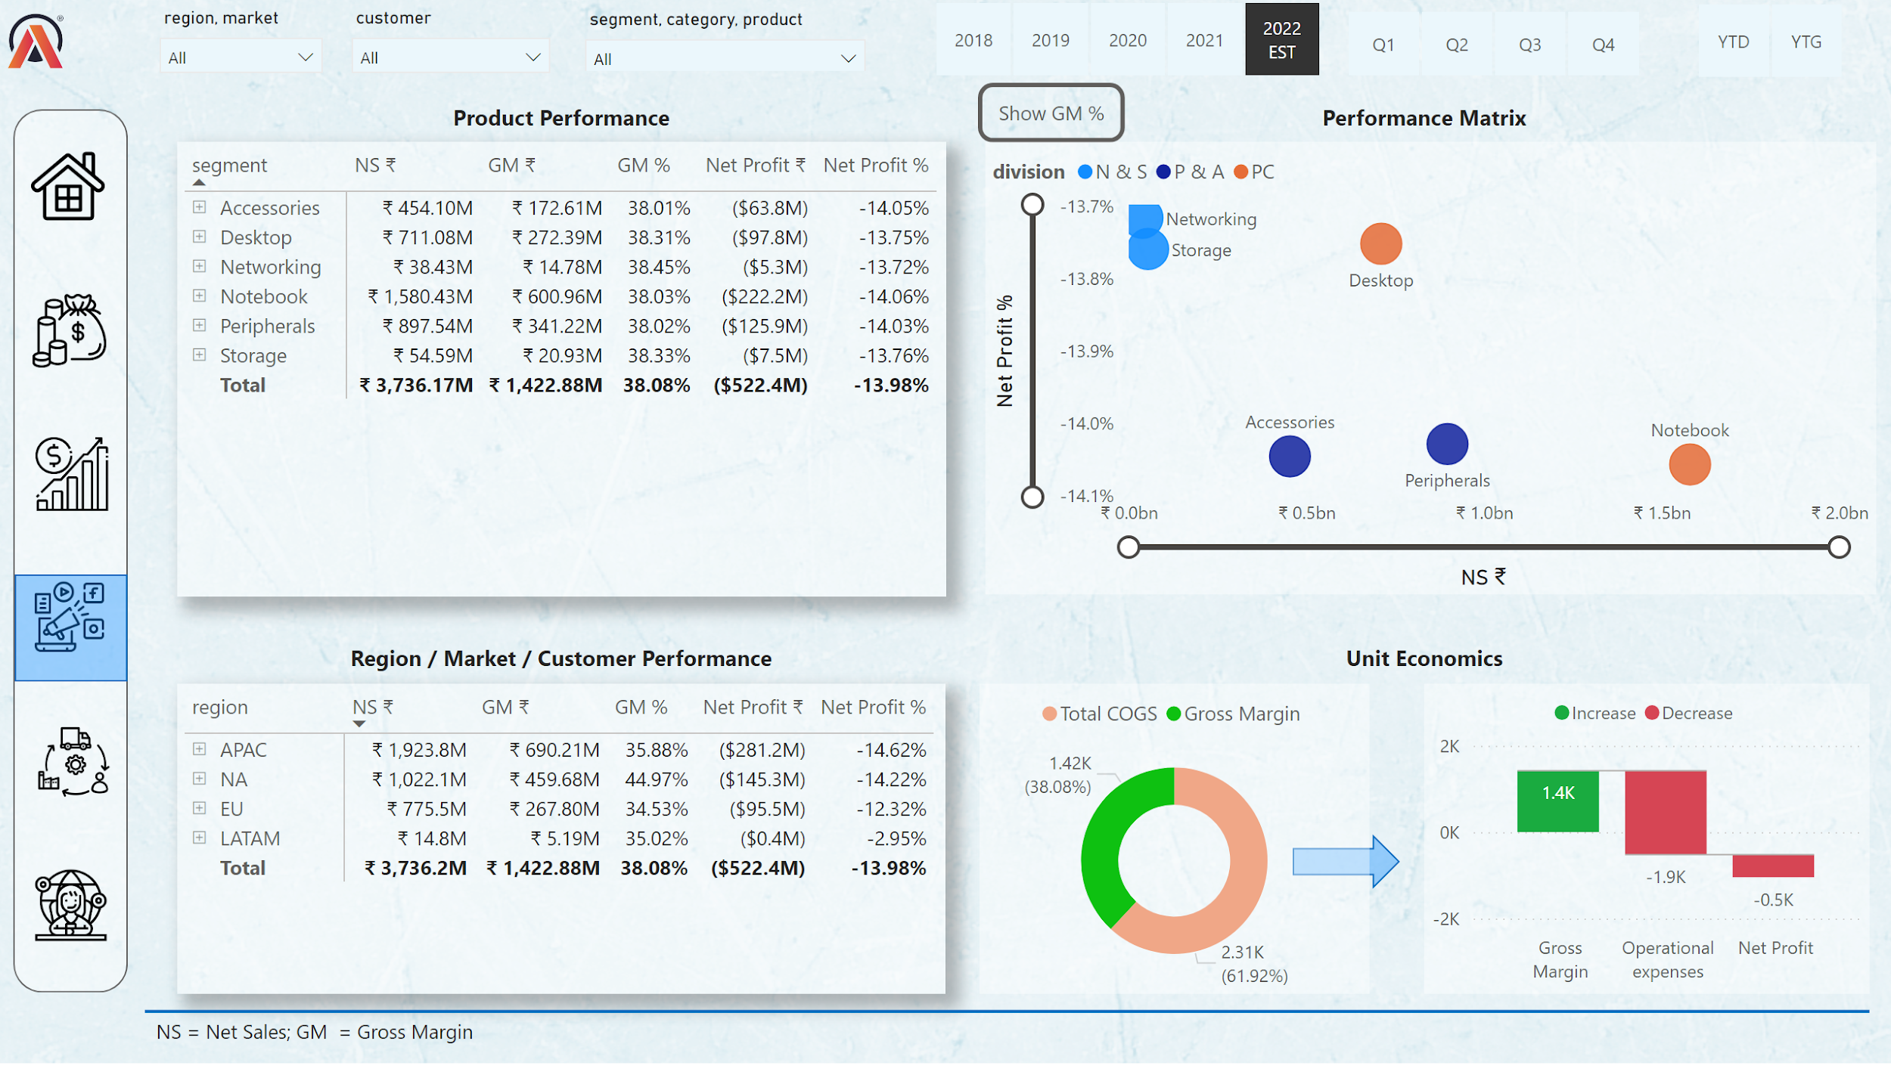
Notes:
slicer
No alt text provided
slicer
No alt text provided
slicer
No alt text provided
slicer
No alt text provided
slicer
No alt text provided
slicer
No alt text provided
image
No alt text provided
shape
No alt text provided
image
No alt text provided
image
No alt text provided
image
No alt text provided
image
No alt text provided
image
No alt text provided
image
No alt text provided
shape
No alt text provided
textbox
No alt text provided
textbox
No alt text provided
shape
No alt text provided
pivotTable
No alt text provided
pivotTable
No alt text provided
textbox
No alt text provided
donutChart
No alt text provided
waterfallChart
No alt text provided
textbox
No alt text provided
actionButton
No alt text provided
scatterChart
No alt text provided
NP % Visual
No alt text provided
GM % Button
No alt text provided
shape
No alt text provided
textbox
No alt text provided

Slide 10
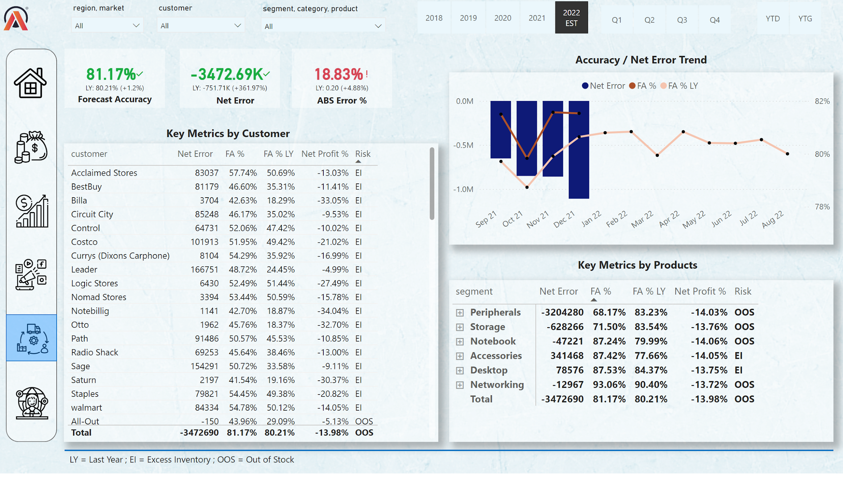
Notes:
slicer
No alt text provided
slicer
No alt text provided
slicer
No alt text provided
Net Sales
No alt text provided
slicer
No alt text provided
slicer
No alt text provided
slicer
No alt text provided
textbox
No alt text provided
kpi
No alt text provided
textbox
No alt text provided
kpi
No alt text provided
kpi
No alt text provided
textbox
No alt text provided
textbox
No alt text provided
image
No alt text provided
shape
No alt text provided
image
No alt text provided
image
No alt text provided
image
No alt text provided
image
No alt text provided
image
No alt text provided
image
No alt text provided
shape
No alt text provided
tableEx
No alt text provided
pivotTable
No alt text provided
textbox
No alt text provided
textbox
No alt text provided
shape
No alt text provided
textbox
No alt text provided

Slide 11
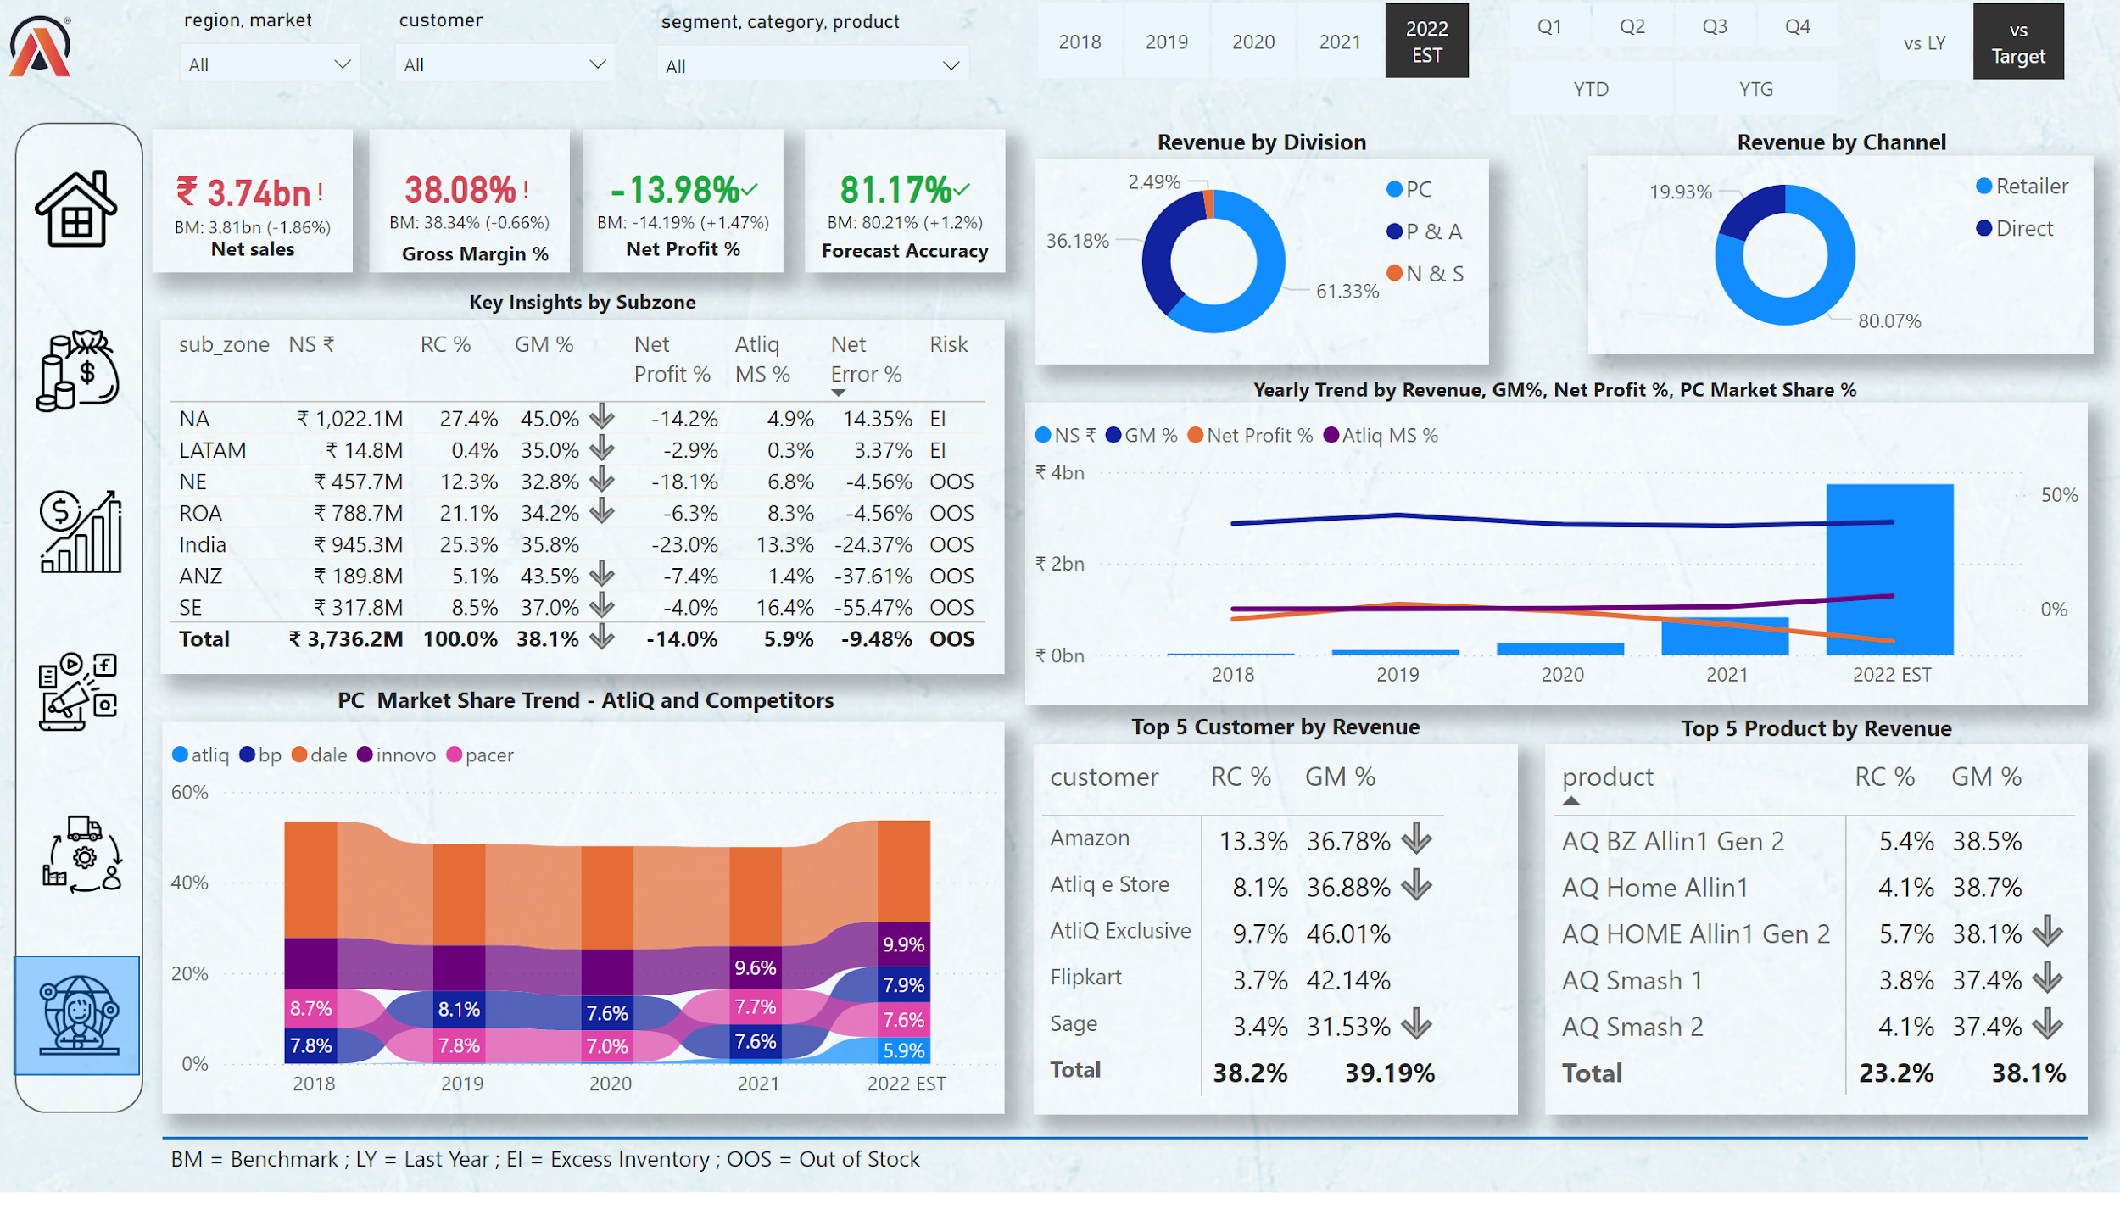
Notes:
slicer
No alt text provided
slicer
No alt text provided
slicer
No alt text provided
pivotTable
No alt text provided
pivotTable
No alt text provided
slicer
No alt text provided
slicer
No alt text provided
slicer
No alt text provided
kpi
No alt text provided
textbox
No alt text provided
kpi
No alt text provided
kpi
No alt text provided
textbox
No alt text provided
textbox
No alt text provided
image
No alt text provided
shape
No alt text provided
image
No alt text provided
image
No alt text provided
image
No alt text provided
image
No alt text provided
image
No alt text provided
image
No alt text provided
shape
No alt text provided
textbox
No alt text provided
slicer
No alt text provided
card
No alt text provided
textbox
No alt text provided
kpi
No alt text provided
donutChart
No alt text provided
textbox
No alt text provided
donutChart
No alt text provided
textbox
No alt text provided
tableEx
No alt text provided
textbox
No alt text provided
lineClusteredColumnComboChart
No alt text provided
textbox
No alt text provided
ribbonChart
No alt text provided
textbox
No alt text provided
textbox
No alt text provided
textbox
No alt text provided
shape
No alt text provided

Slide 12
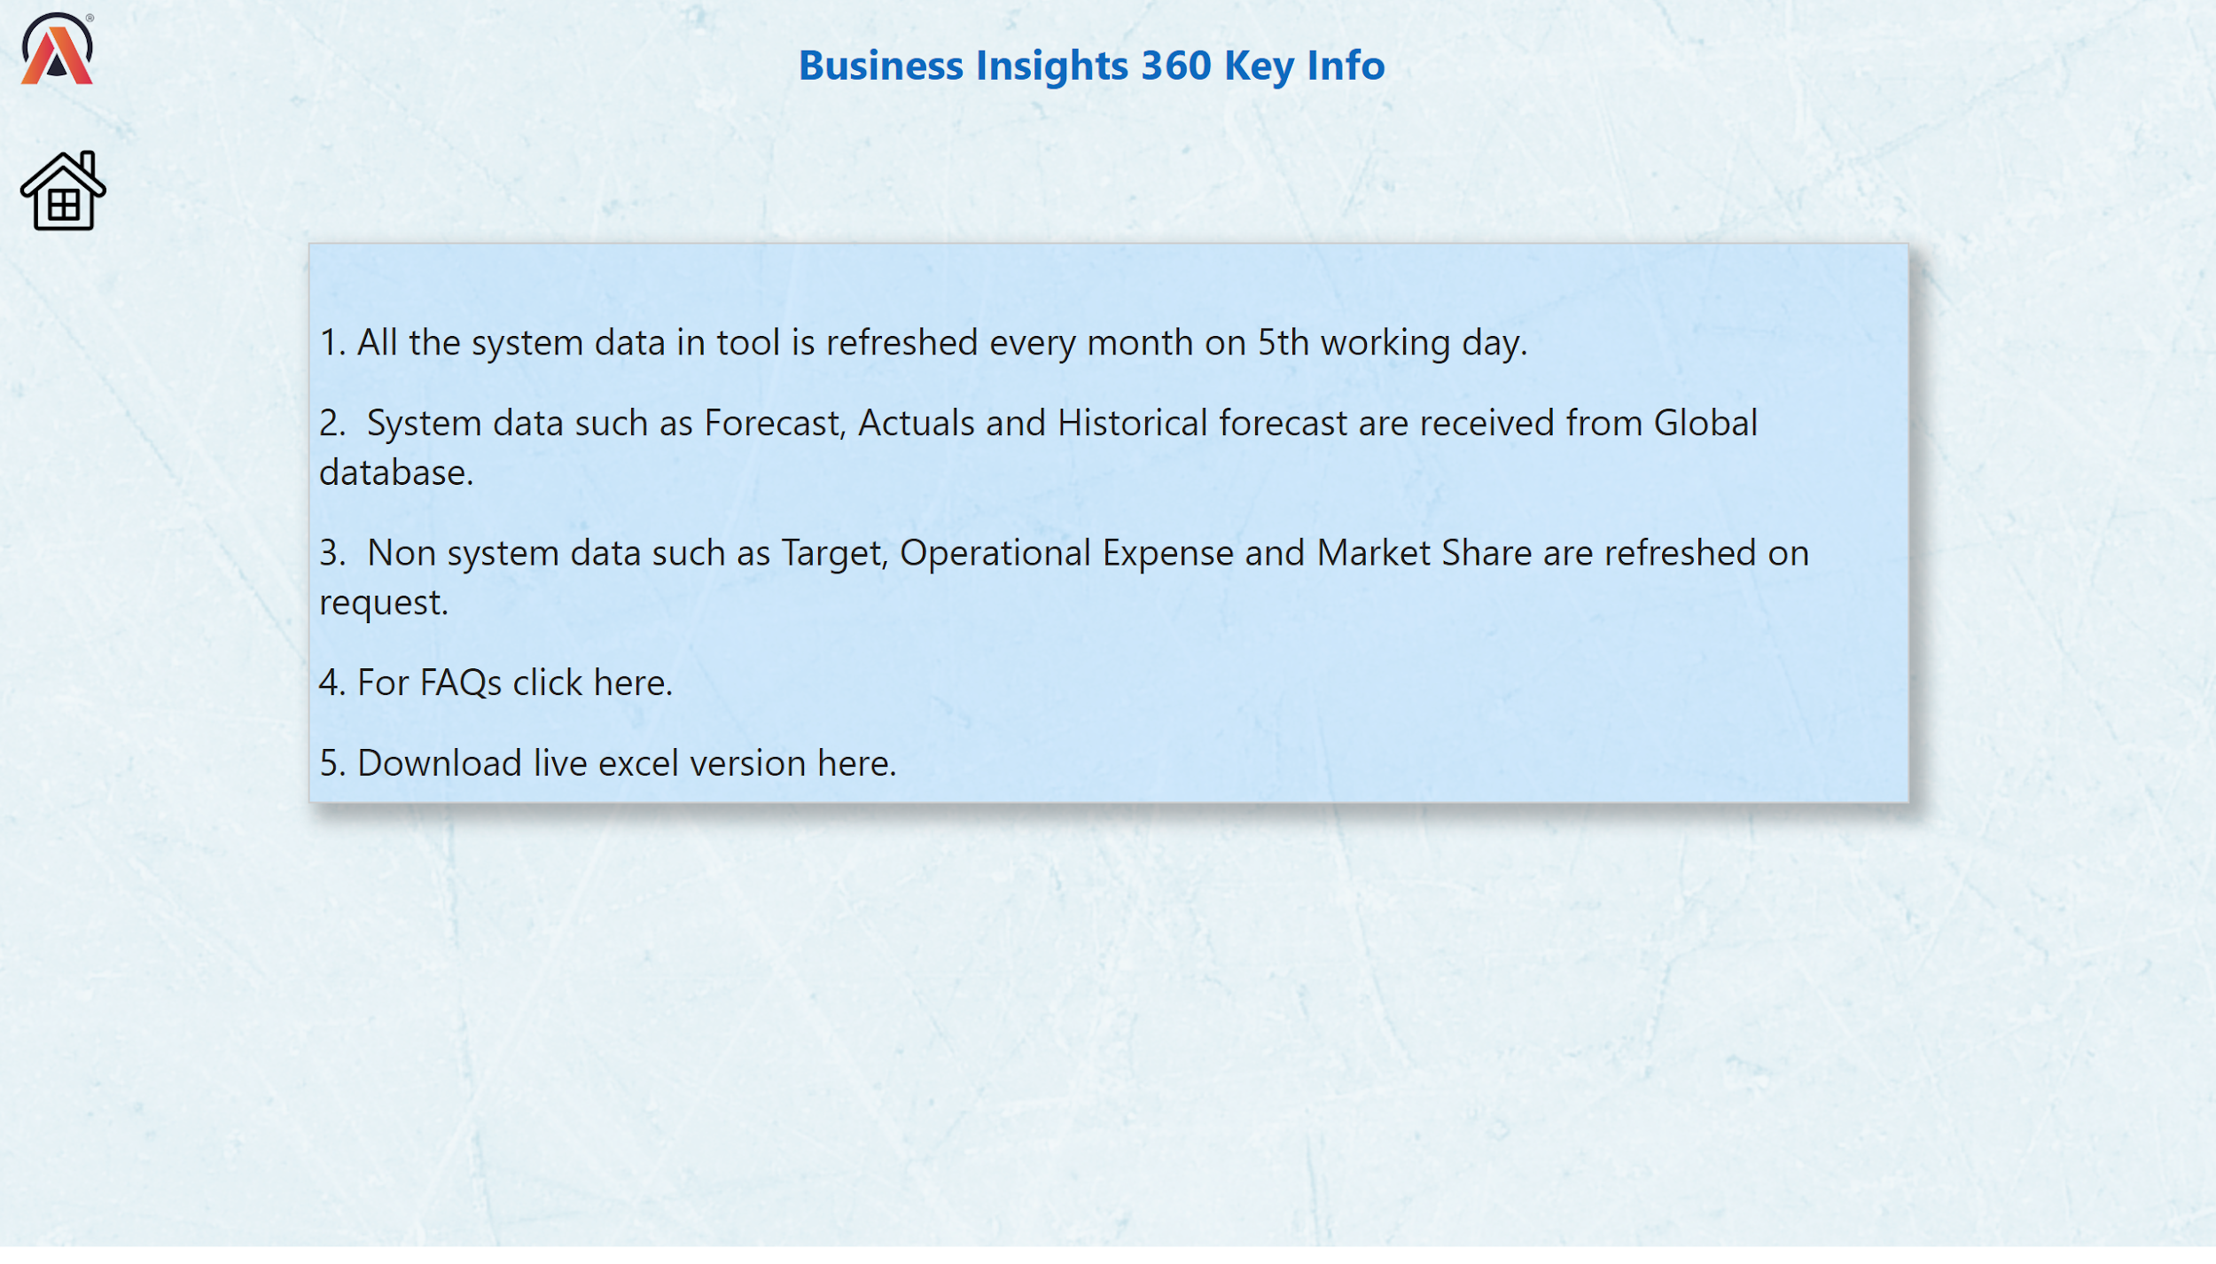
Notes:
image
No alt text provided
image
No alt text provided
textbox
No alt text provided
textbox
No alt text provided

Slide 13
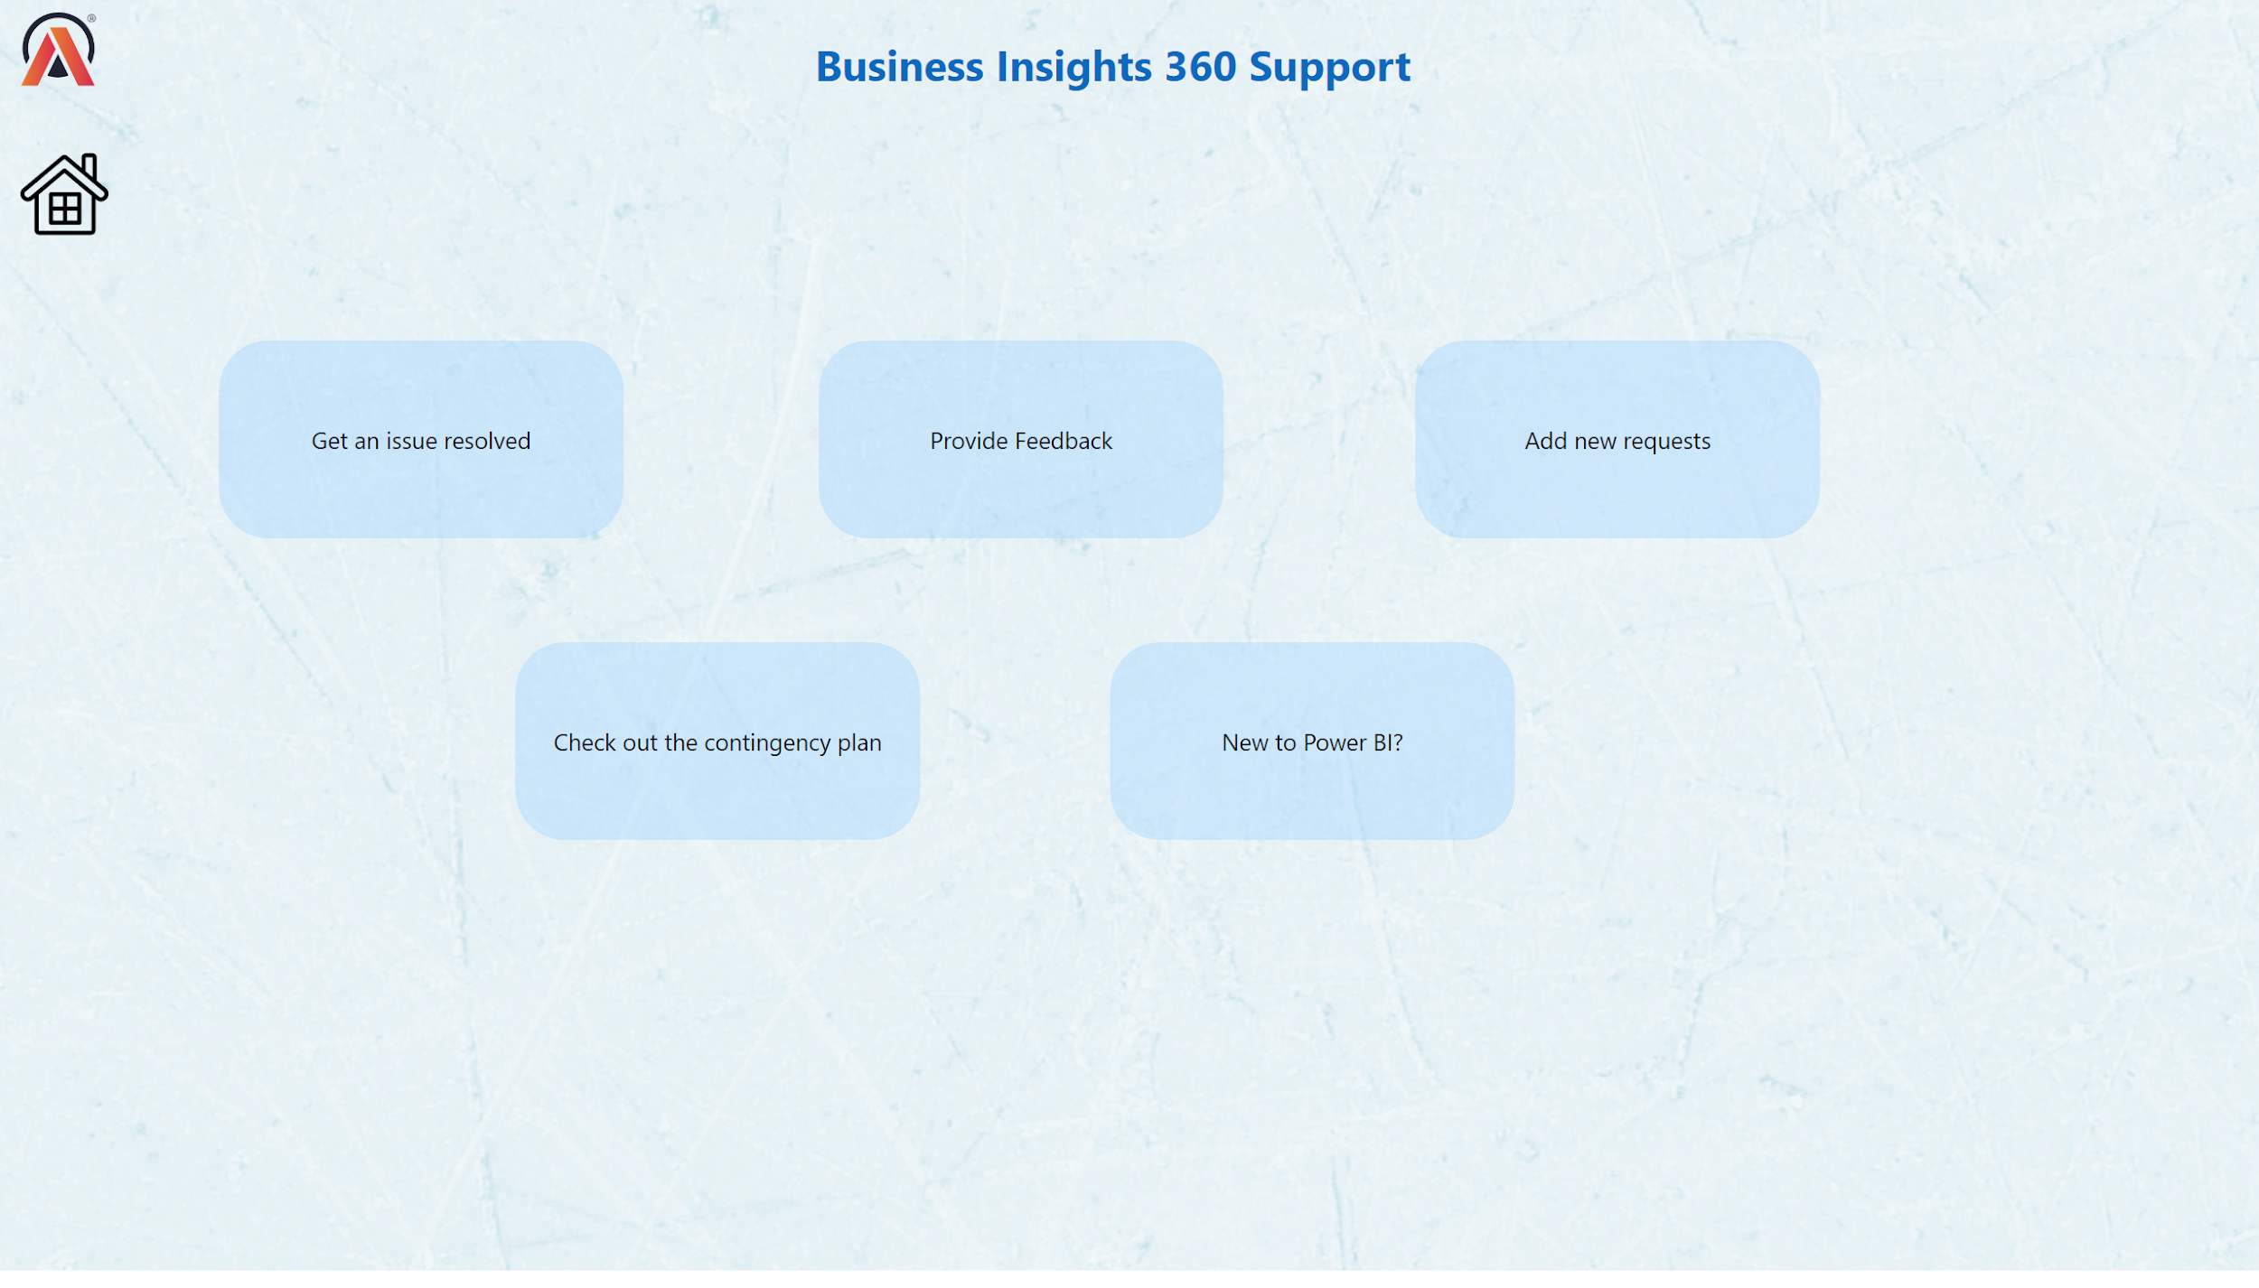
Notes:
image
No alt text provided
image
No alt text provided
shape
No alt text provided
shape
No alt text provided
shape
No alt text provided
shape
No alt text provided
shape
No alt text provided
textbox
No alt text provided

